Slide 2
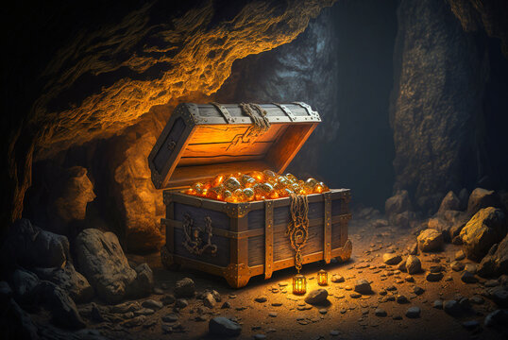
“I will give you the treasures of darkness, and riches hidden in secret places, so that you will know that it is I, the Lord, the God of Israel, who calls you by your name.”
Isaiah 45 v 3

Slide 3
“But we have this treasure in jars of clay, to show that the surpassing power belongs to God and not to us. We are afflicted in every way, but not crushed; perplexed, but not driven to despair; persecuted, but not forsaken; struck down, but not destroyed; always carrying in the body the death of Jesus, so that the life of Jesus may also be manifested in our bodies.”
2 Corinthians 4 v 7-9

Slide 4
Afflicted?
Perplexed?
Persecuted or criticized?
Struck down?
Sometimes ..........
But we have this treasure!

Slide 5
How are we responding to this calling?

Slide 6
GROWING
Creative use of land and buildings
Different ways of “doing life” together to support discipleship
Contextual engagement with communities
Creativity in worship
Commitment to respond to climate crisis
Development of New Places for New People

Slide 7
INCLUSIVE
More use of different languages
Deeper listening to other voices and views
Adaptation of properties to increase facilities and accessibility
Provision of online / digital worship

Slide 8
CONVERSATION
What you have noticed GROWING where you are that is positive? What do you sense needs to be nurtured so that further GROWTH can happen and what support with that would you welcome?
What positive steps towards greater INCLUSIVITY have been taken where you are? What might the next steps look like and what support with that would you welcome?

Slide 9
EVANGELISTIC
“Open The Book” being used in schools
Pop-up or mobile churches on the move
Beach pastors / Street pastors where people are
Methodist Way of Life resources being used in the Armed Forces
Godly Play being used in many contexts
Chaplains serving in countless places

Slide 10
JUSTICE-SEEKING
Second-hand school uniform projects
Distribution of surplus supermarket food
Partnering with community groups against injustice
Telling the story of our transformational work through the years
Launching “Let’s End Poverty”

Slide 11
CONVERSATION
What steps in EVANGELISM are being taken where you are? What opportunities have you spotted where more could be done and what support with that would you welcome?
What JUSTICE-SEEKING is happening where you are? Who else are you feeling called to stand with or be alongside and what support with that would you welcome?

Slide 12
Focus on the “treasure” within!

Slide 13
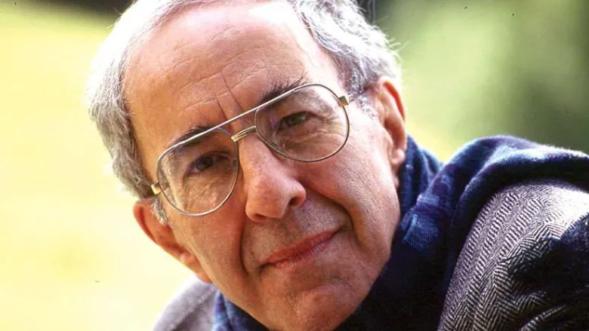
“We must learn to live each day, each hour, yes, each minute as a new beginning, as an opportunity to make everything new. Imagine that we could live each moment as a moment pregnant with new life. Imagine that we could live each day as a day full of promises. Imagine that we could walk through the year always listening to a voice saying to us, “I have a gift for you and can’t wait for you to see it!”
Henri Nouwen
January 24 1932 – September 21 1996
Dutch Catholic priest, professor, writer and theologian

Slide 14
Don’t focus on what we don’t have or what we don’t have time for!
Look for the glimmers of hope and the treasure that is all around us and pursue that instead!

